Slide 1
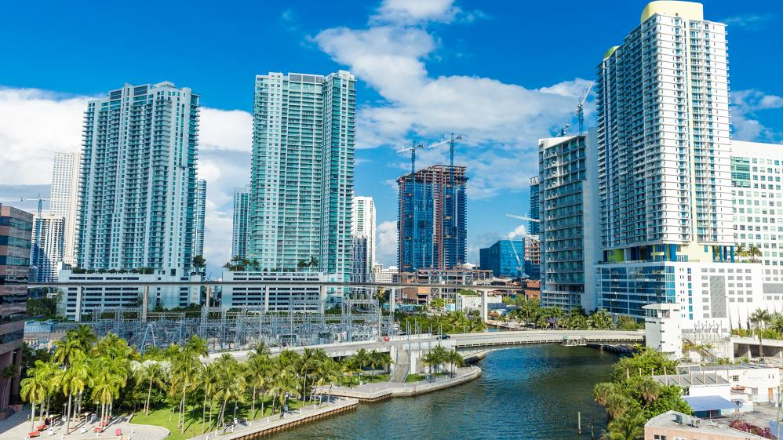
City of Miami
RESILIENT WATERFRONT enhancement plan
designing green–gray Infrastructure for the City of Miami’s waterfront
Sonia Brubaker, Chief Resilience Officer
Presentation to Miami River Commission Subcommittee
July 21, 2023

Slide 2
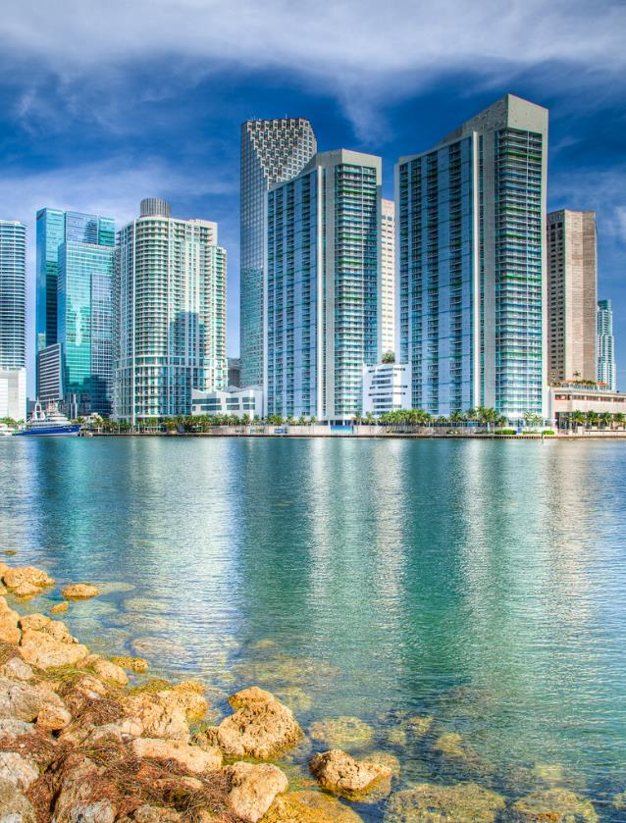
  CITY OF MIAMI
  RESILIENT WATERFRONT ENHANCEMENT PLAN
Grant from National Fish and Wildlife Foundation to develop plan to:
Enhance City-owned waterfront property with nature-based designs
Identify pilot project sites to serve as prototypes for similar shorelines
Address permitting, funding, design, and maintenance hurdles of nature-based designs
Align with ongoing City resilience initiatives
  Goal 3 of the Miami Forever Climate Ready Strategy
  Stormwater Master Plan
  City Seawall Ordinance
  Resilient 305
  Miami21 Appendix B – Waterfront Guidelines

Slide 3
  CITY OF MIAMI
  RESILIENT WATERFRONT ENHANCEMENT PLAN
4 Different Typologies
End-of-Road on Riverfront
End-of-Road on Bayfront
Park on Riverfront
Park on Bayfront
Each Typology has 3 Options
These options go from simplest to more complex
We used real locations within the City but they are not final designs and not currently being planned – goal is to have resilient examples that can be used in these or other sites

Slide 4
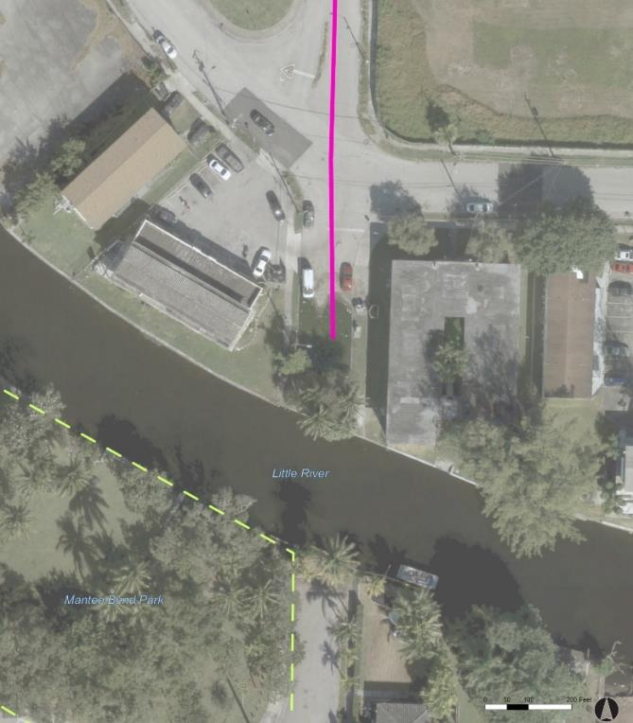
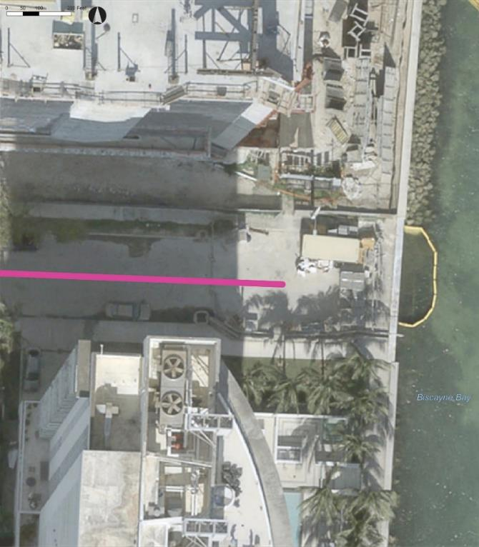
  Typology 1: End-of-Road on Riverfront
  Typology 2: End-of-Road on Bayfront
LOCATION: NE 5th Ave (near NE 79th St and Little River)
LOCATION: NE 26th St

Slide 5
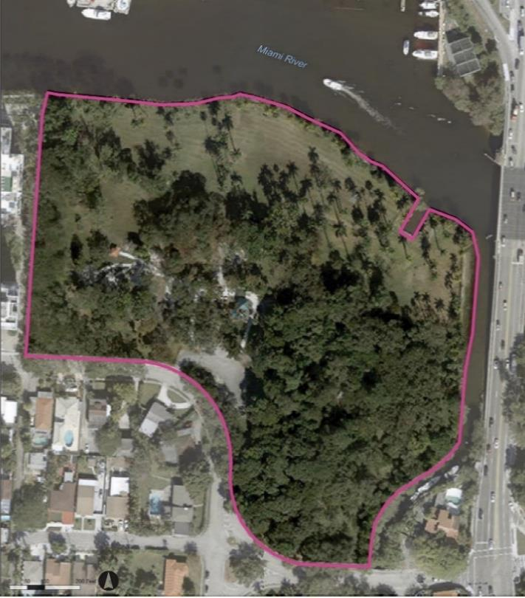
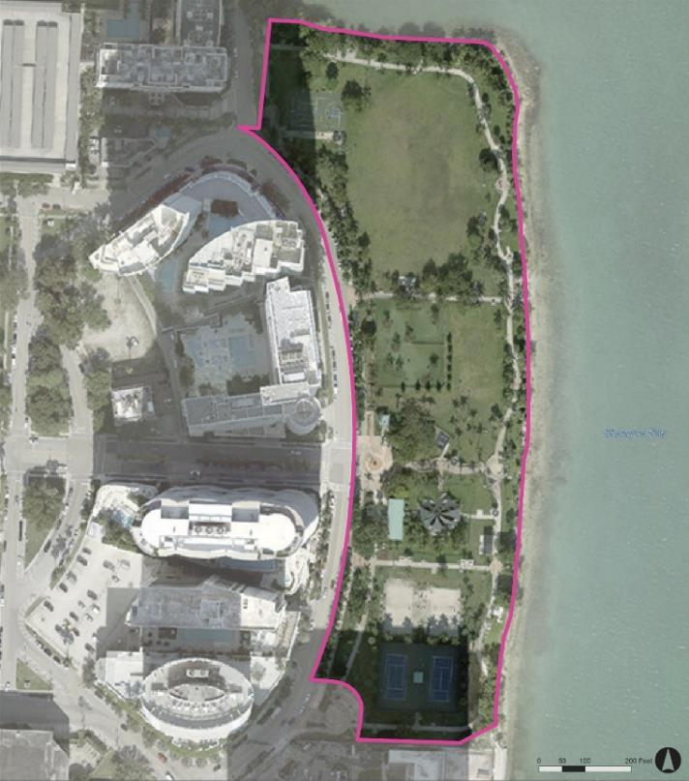
  Typology 3: Park on Riverfront
  Typology 4: Park on Bayfront
LOCATION: Sewell Park
LOCATION: Margaret Pace Park

Slide 6
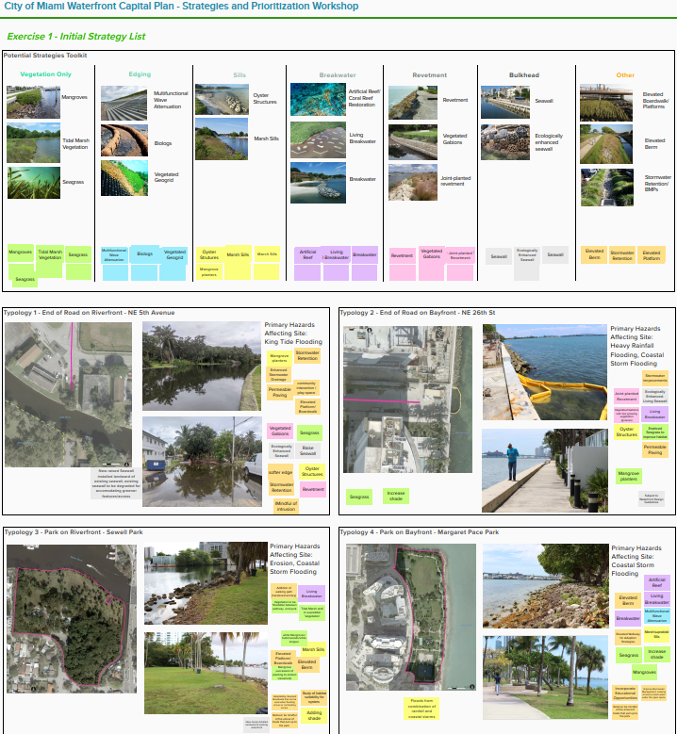
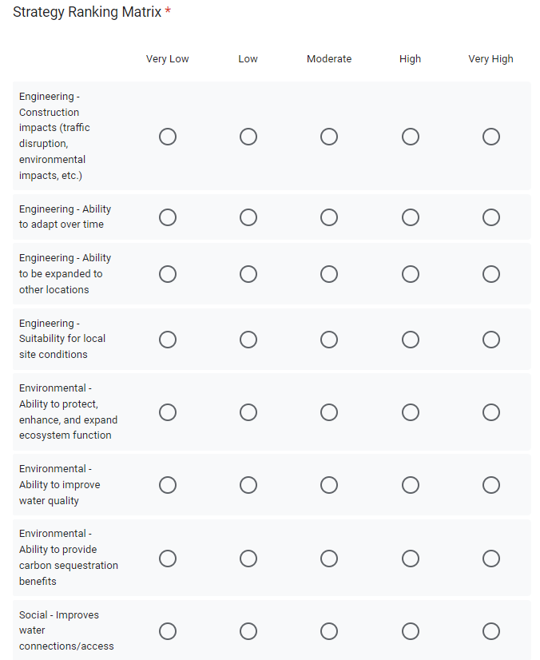
  Develop & Prioritize Strategies
Held a Dept workshop to brainstorm strategy ideas for each typology
Strategy “menu” ranged from green to gray
Short-list strategies were evaluated to understand tradeoffs and preferences:
  Engineering
  Environmental
  Social
  Implementation Feasibility

Slide 7
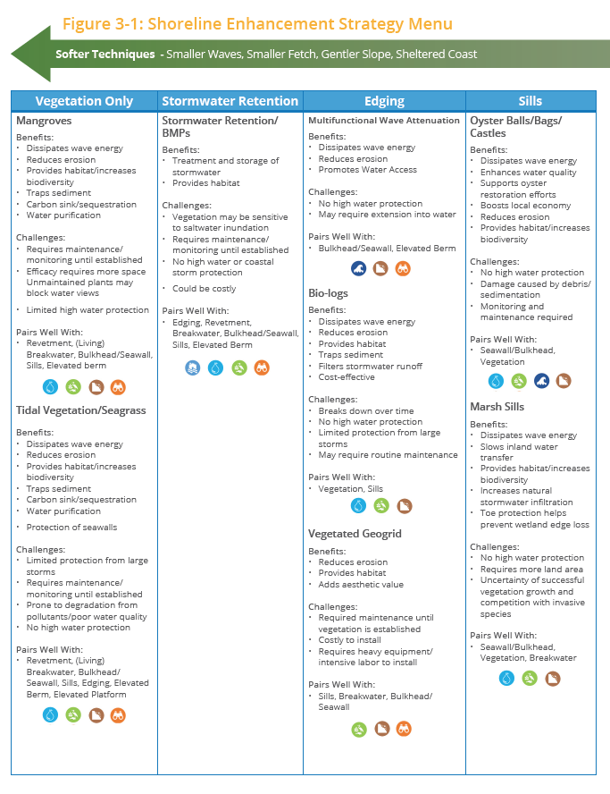
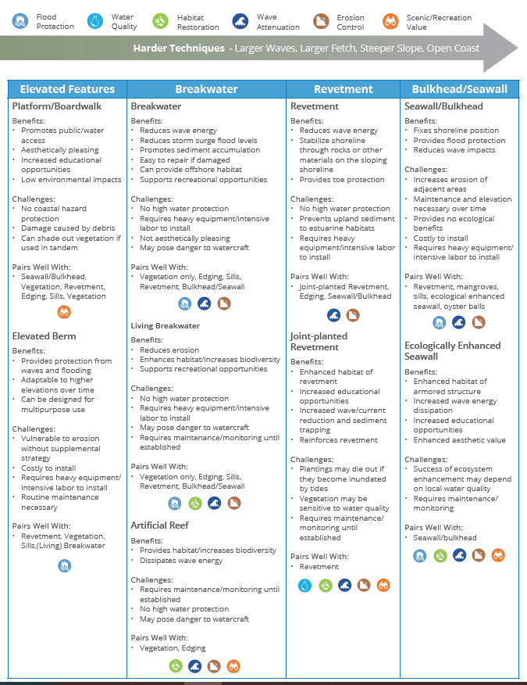
  Strategy Menu

Slide 8
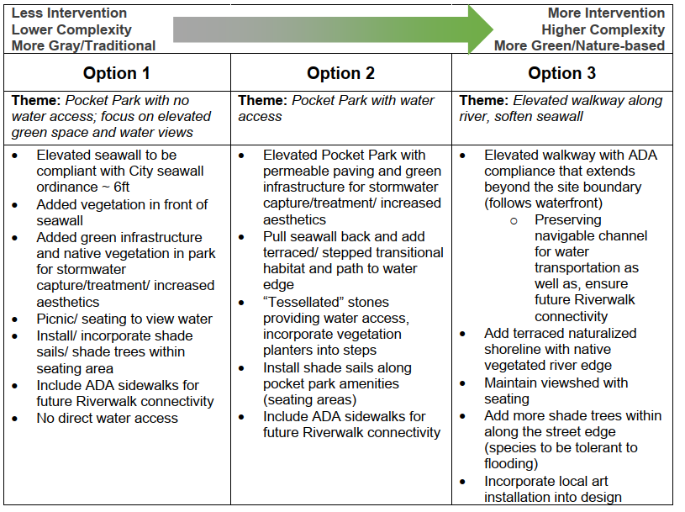
  Combining Strategies into Alternatives
Individual strategies grouped into alternatives (options)
Up to 3 options for each typology location
Covers range of nature-based interventions
Example from End-of-Road on Riverfront

Slide 9
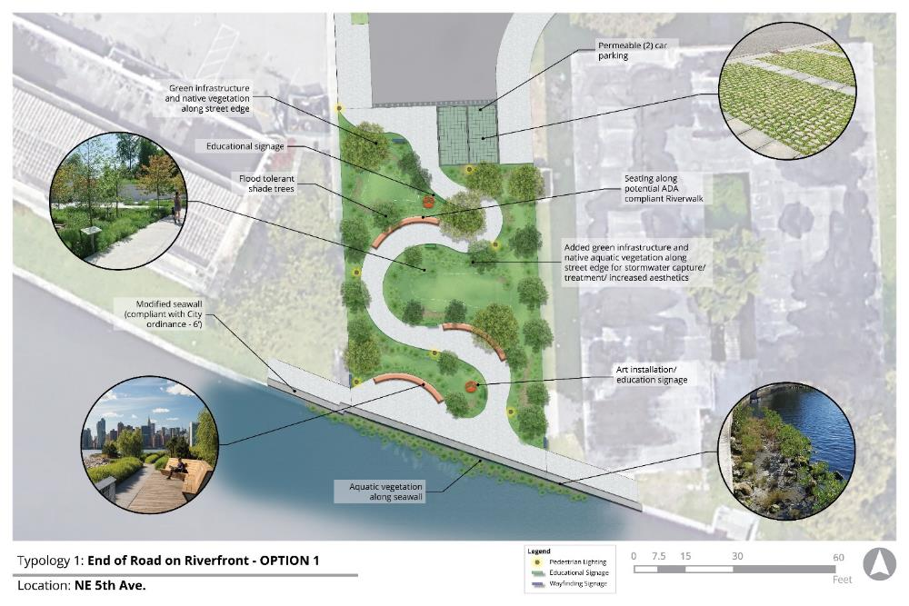
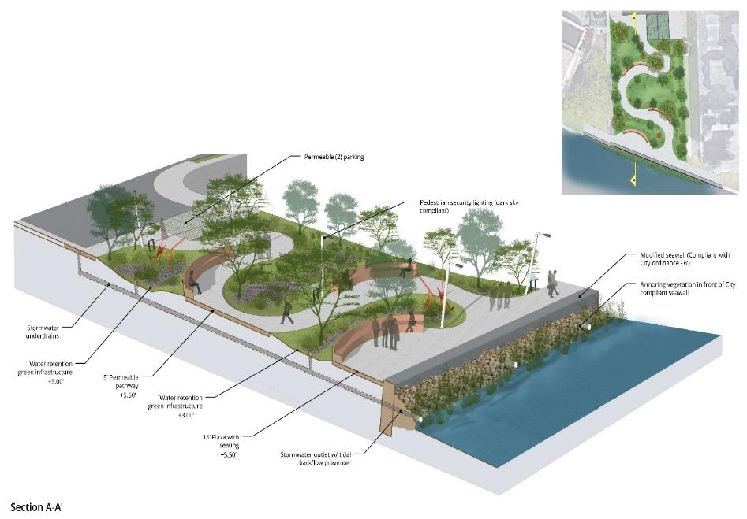
  Typology 1 – End-of-Road on the Riverfront
  NE 5th Ave
  Option 1

Slide 10
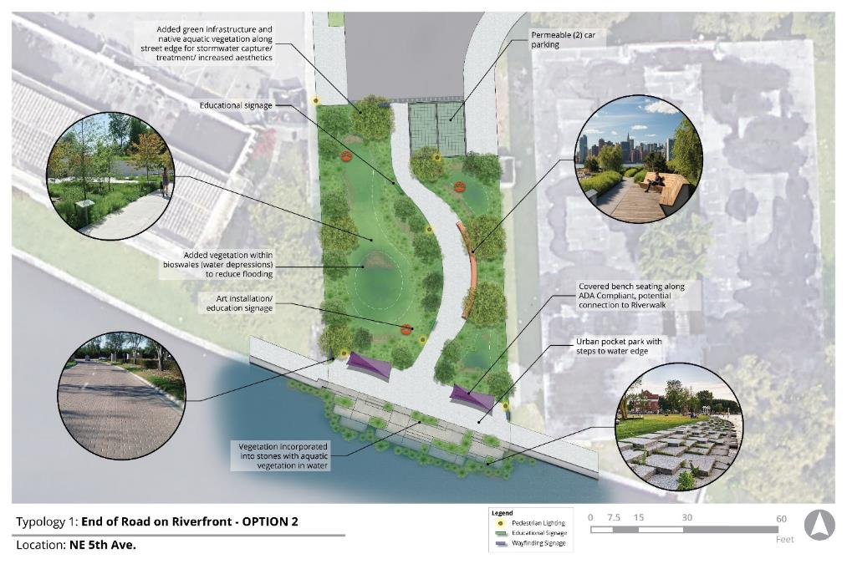
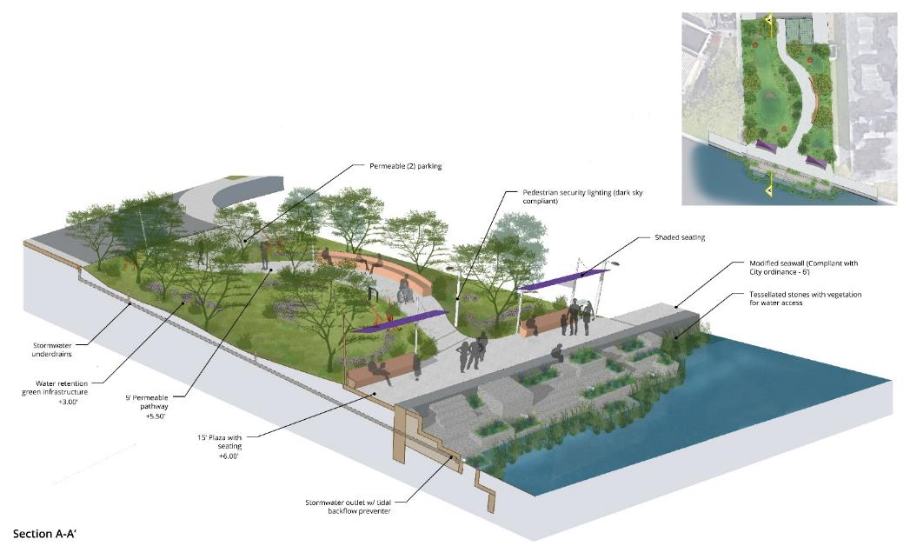
  Typology 1 – End-of-Road on the Riverfront
  NE 5th Ave
  Option 2

Slide 11
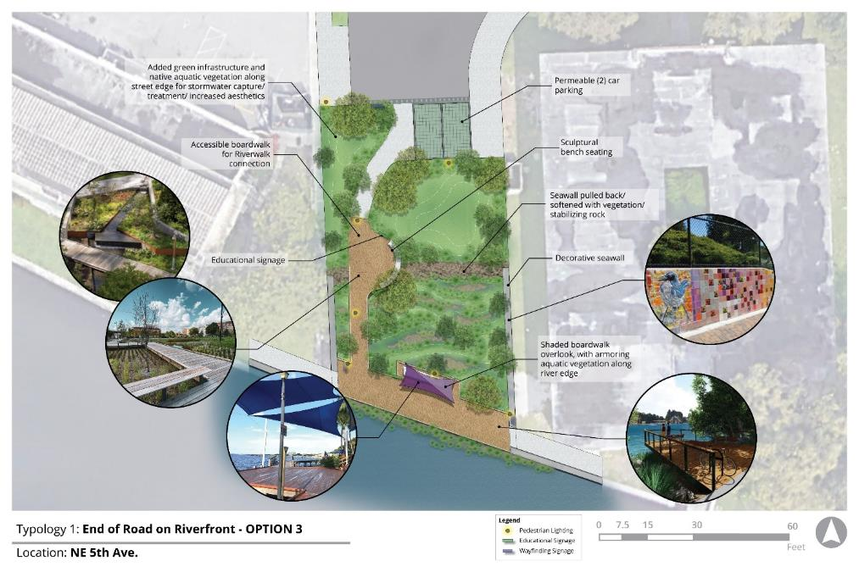
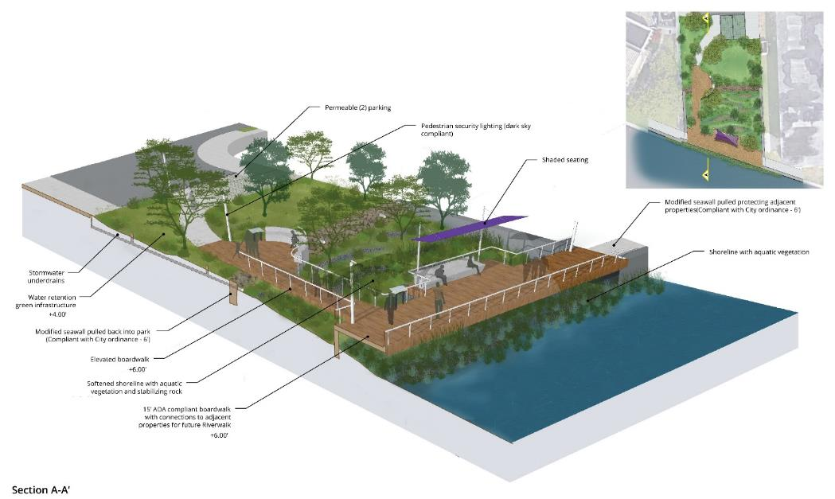
  Typology 1 – End-of-Road on the Riverfront
  NE 5th Ave
  Option 3

Slide 12
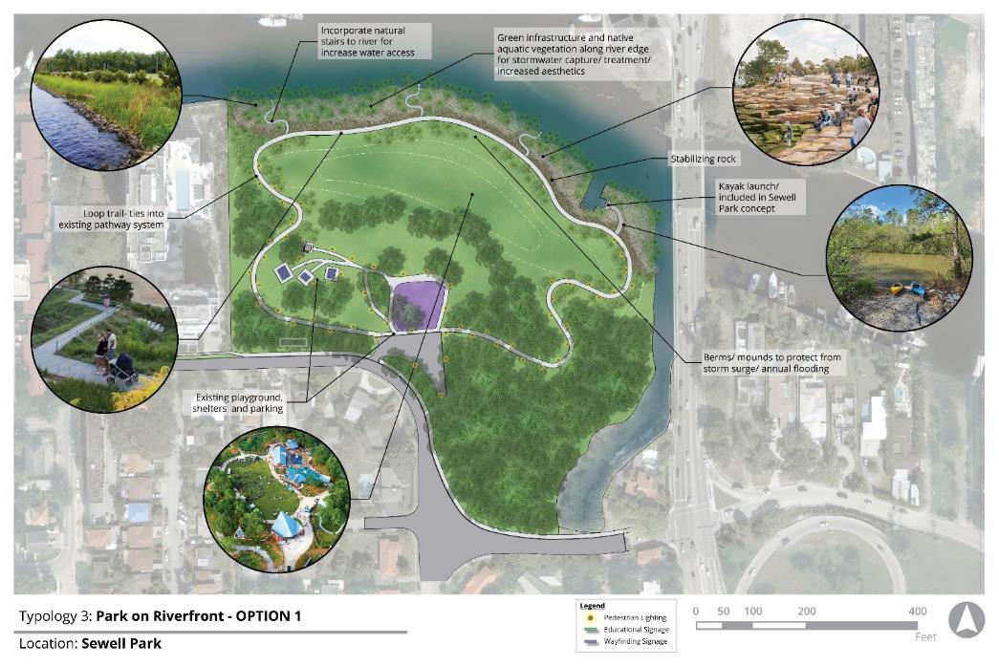
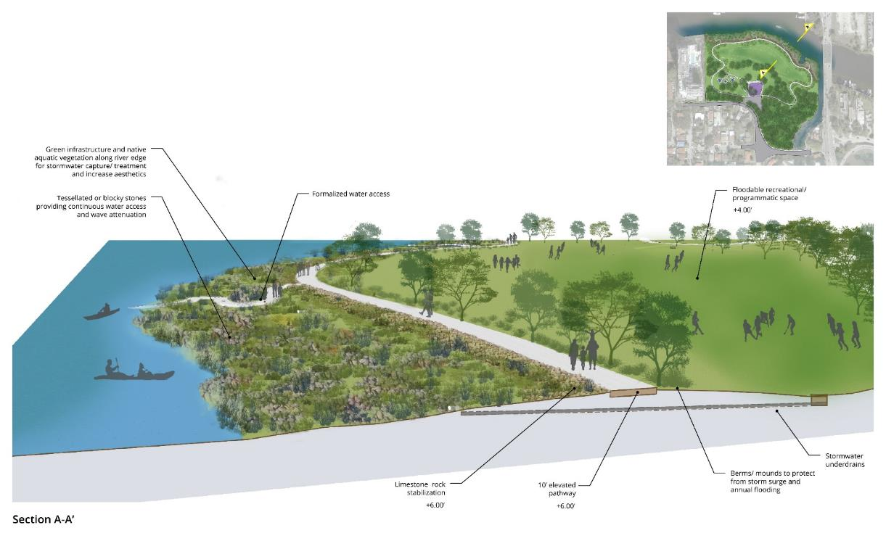
  Typology 3 – Park on the Riverfront
  Sewell Park
  Option 1

Slide 13
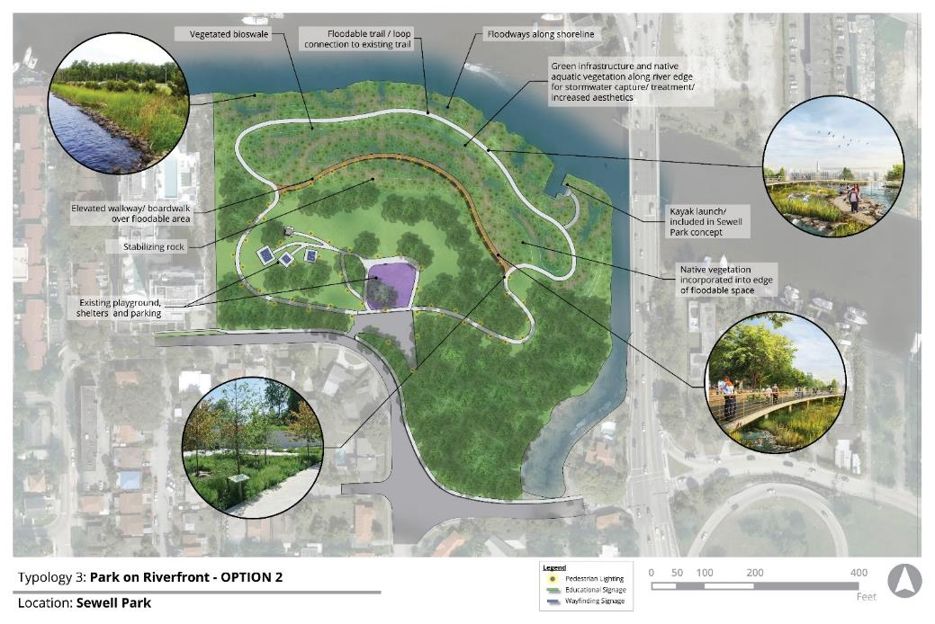

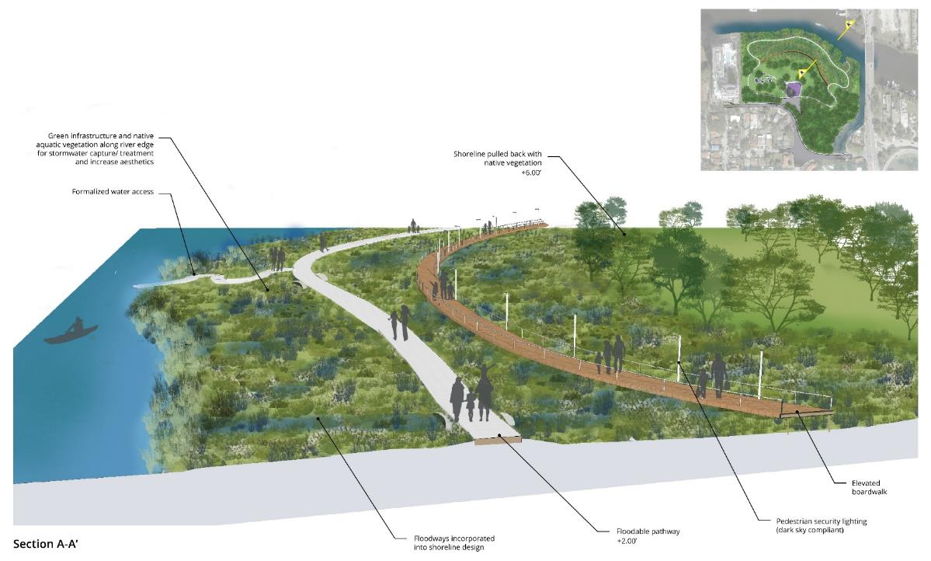
  Typology 3 – Park on the Riverfront
  Sewell Park
  Option 2
(Elevated Shoreline with Increased Accessibility)

Slide 14
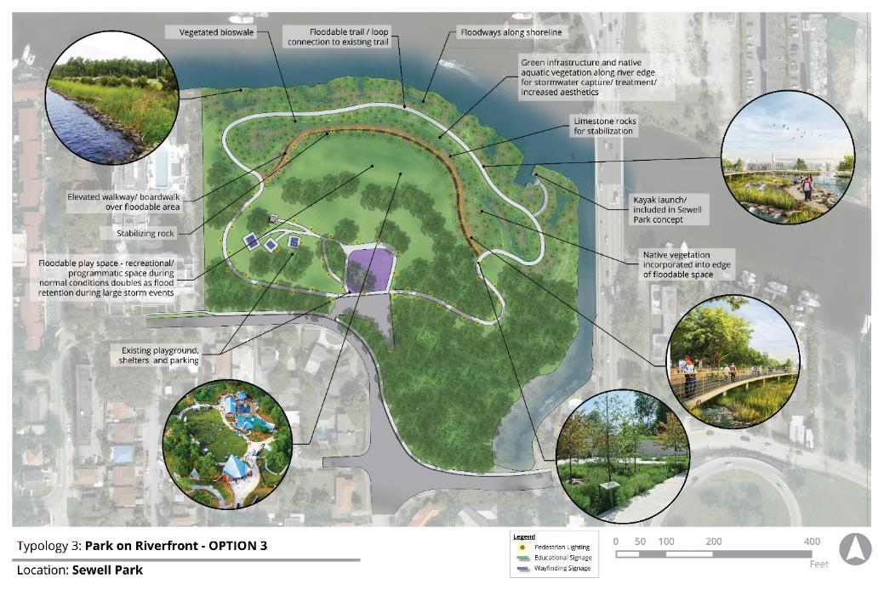
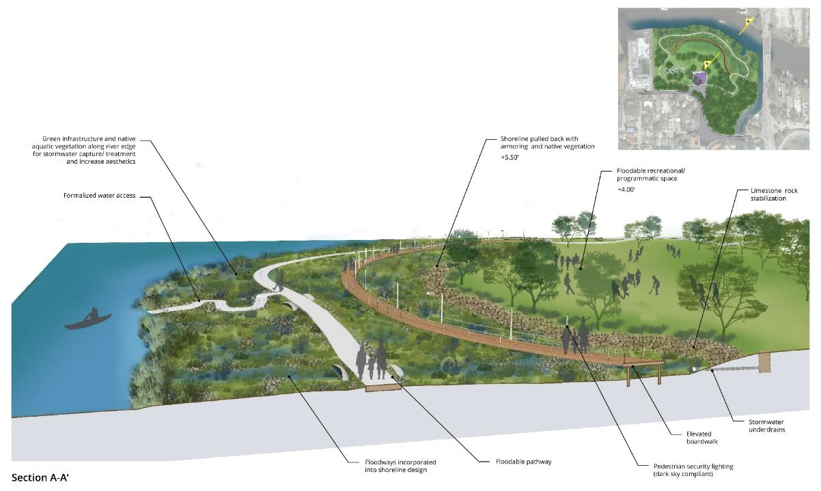
  Typology 3 – Park on the Riverfront
  Sewell Park
  Option 3

Slide 15
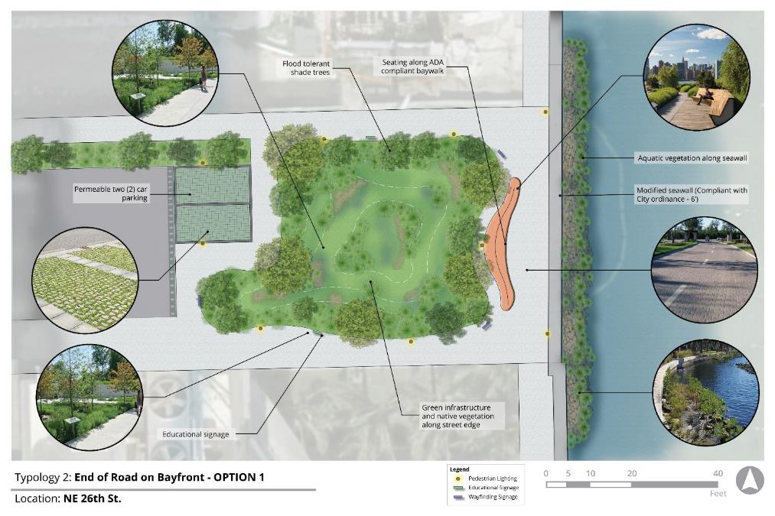
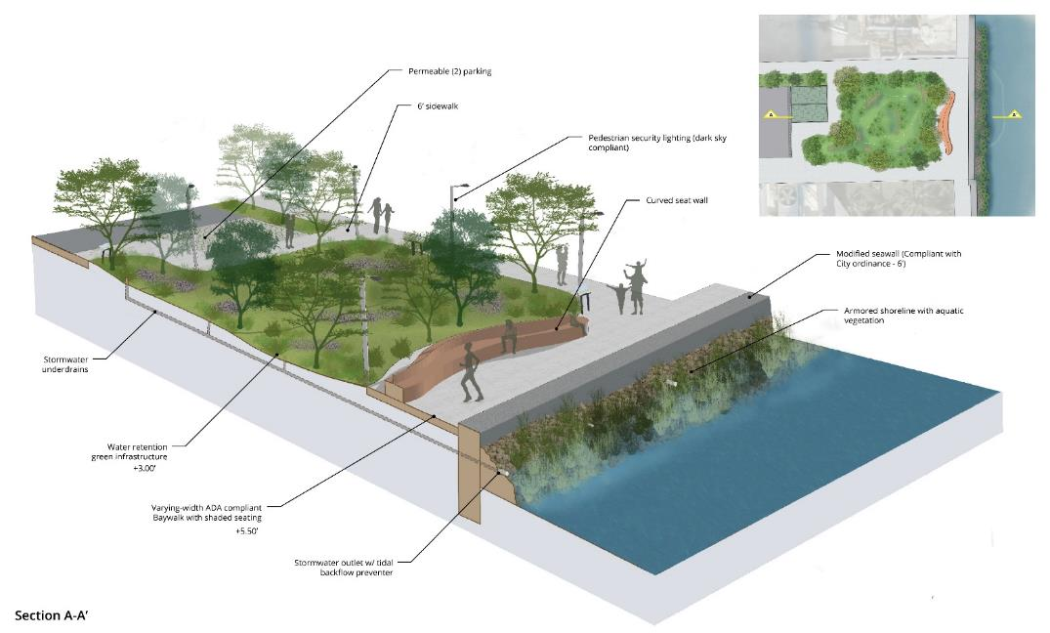
  Typology 2 – End-of-Road on the Bayfront
  NE 26th St
  Option 1

Slide 16
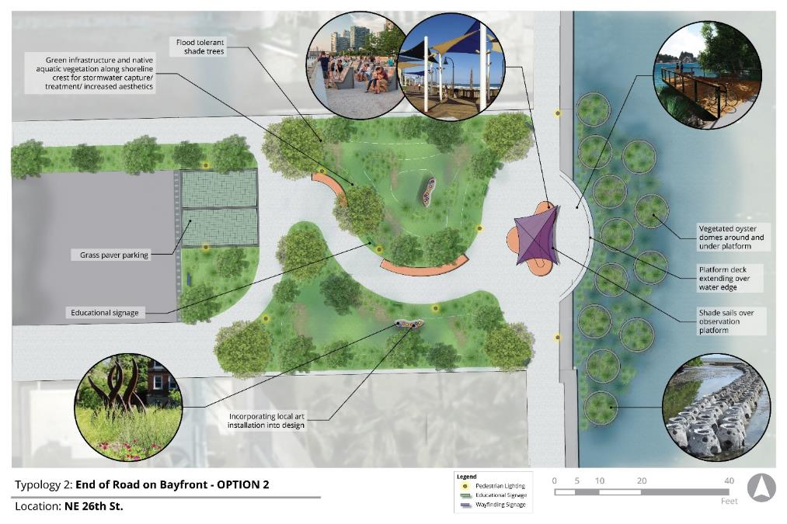
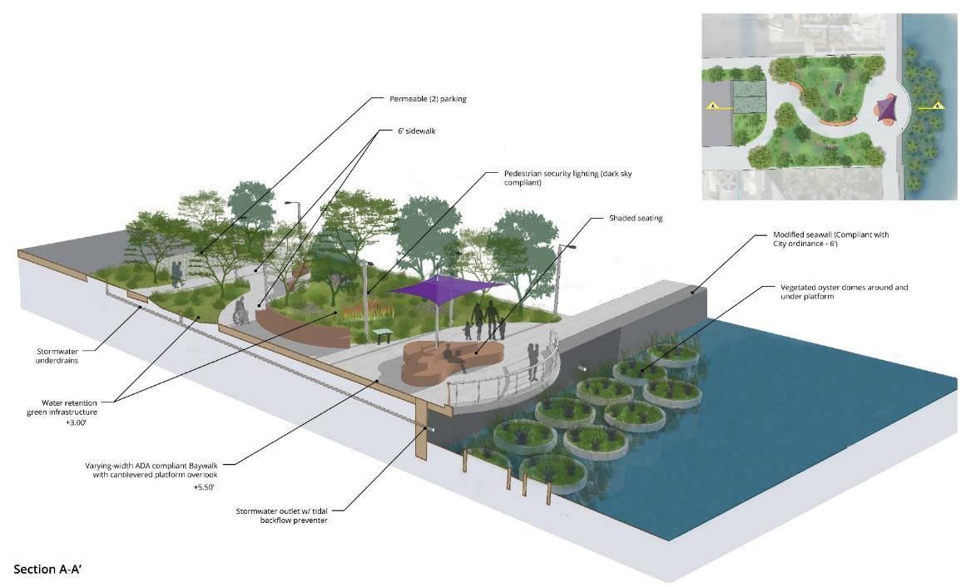
  Typology 2 – End-of-Road on the Bayfront
  NE 26th St
  Option 2

Slide 17
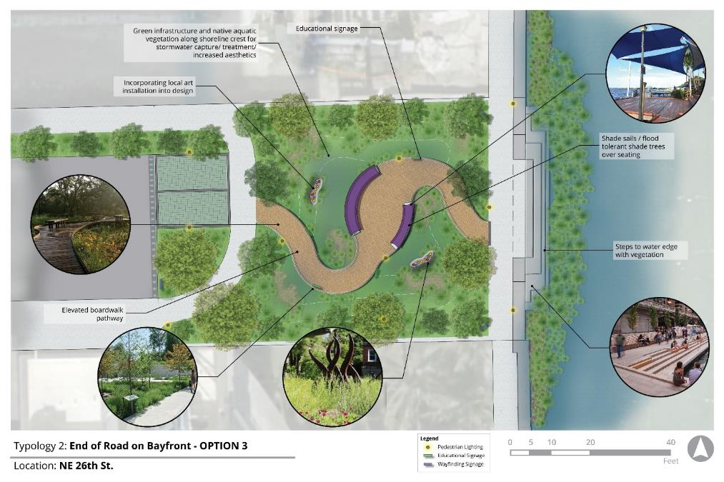
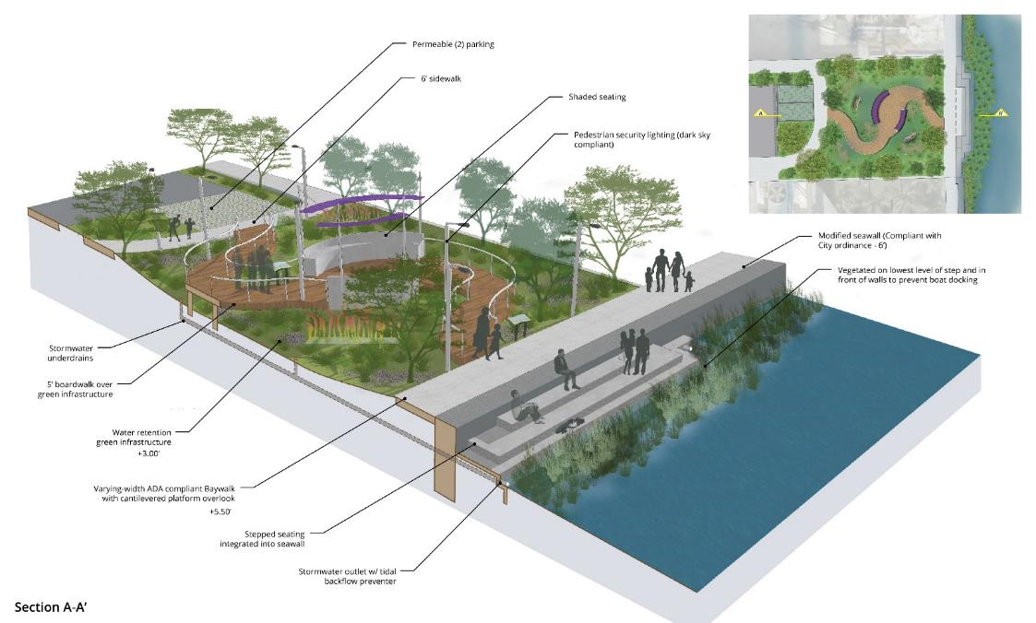
  Typology 2 – End-of-Road on the Bayfront
  NE 26th St
  Option 3

Slide 18
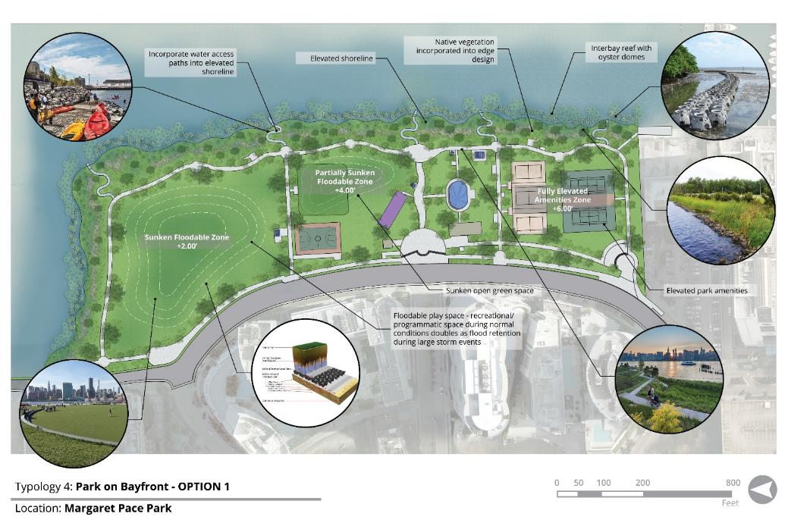
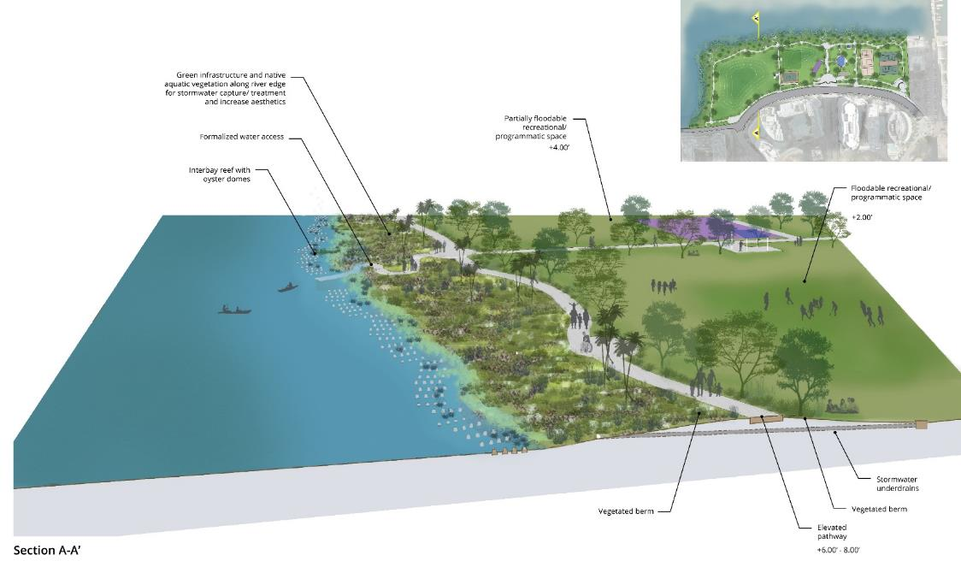
  Typology 4 – Park on the Bayfront
  Margaret Pace Park
  Option 1

Slide 19
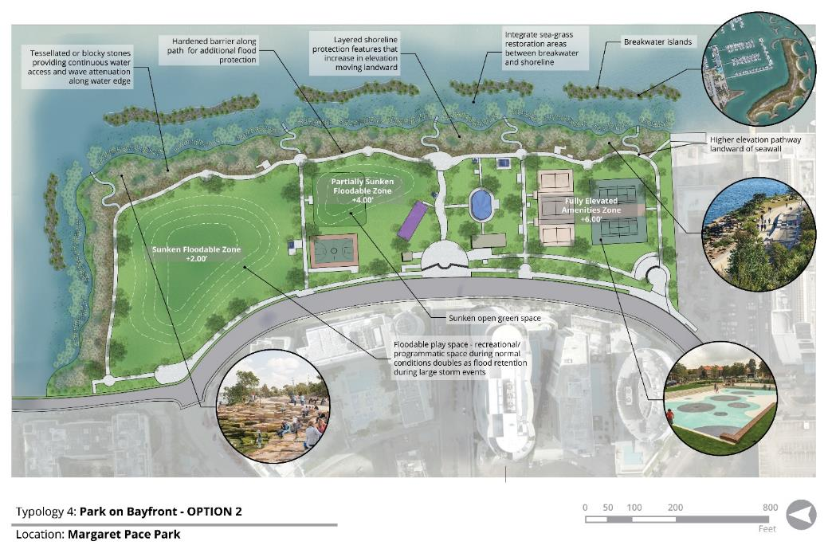
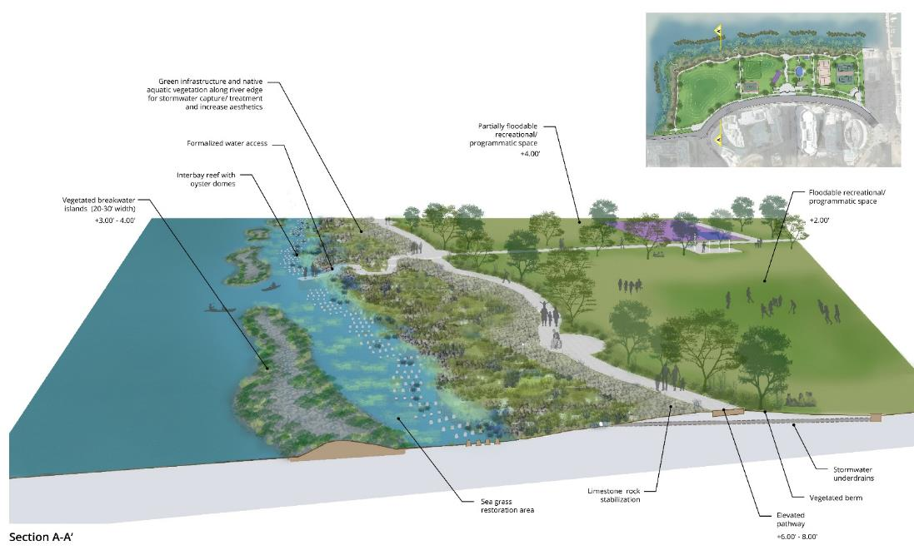
  Typology 4 – Park on the Bayfront
  Margaret Pace Park
  Option 2

Slide 20
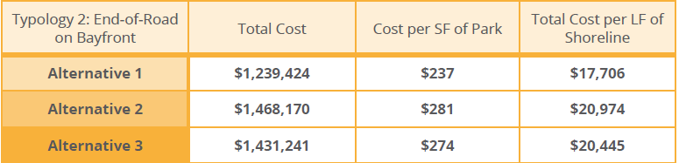
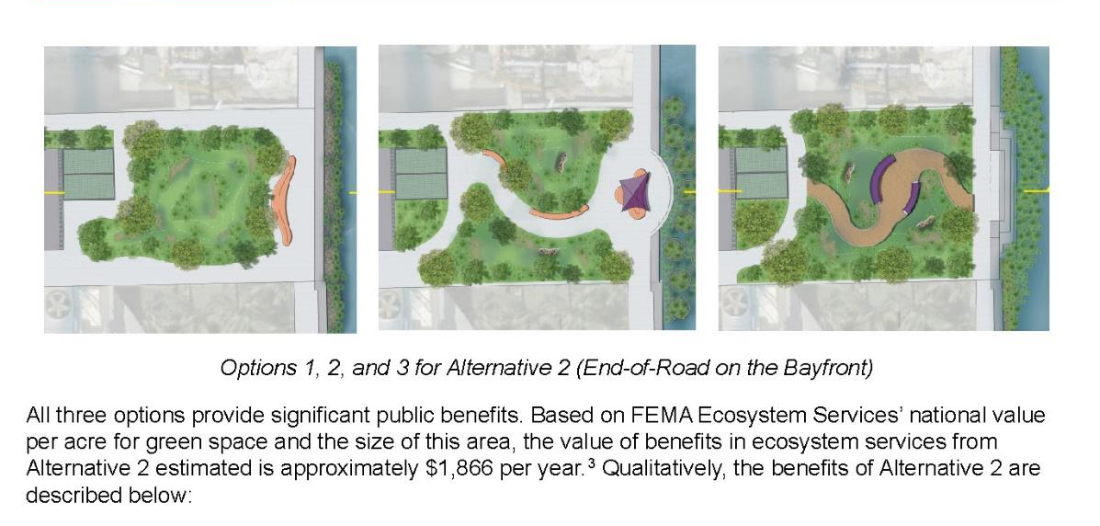
  Cost Estimates & Benefit Evaluation
Cost estimates for each alternative – total, per SF, and per LF of shoreline
Benefits quantified using FEMA Ecosystem Services’ national value per acre for green space

Slide 21
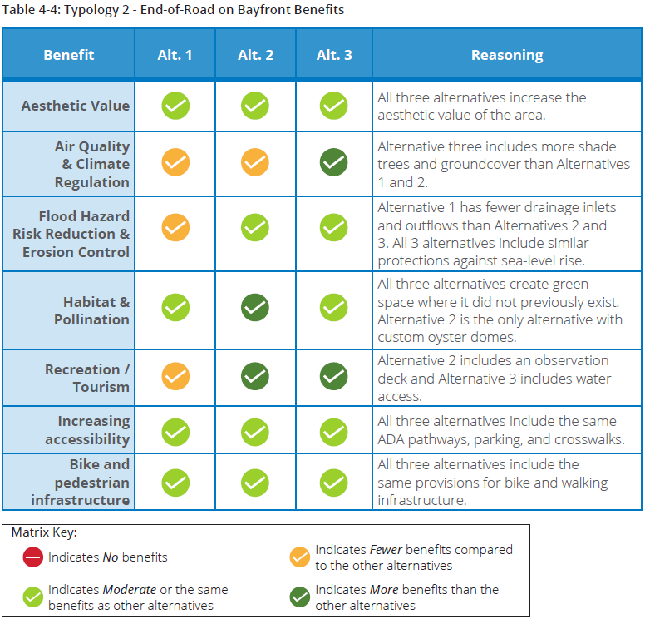
  Cost Estimates & Benefit Evaluation
Qualitative benefits evaluated based on 7 factors

Slide 22
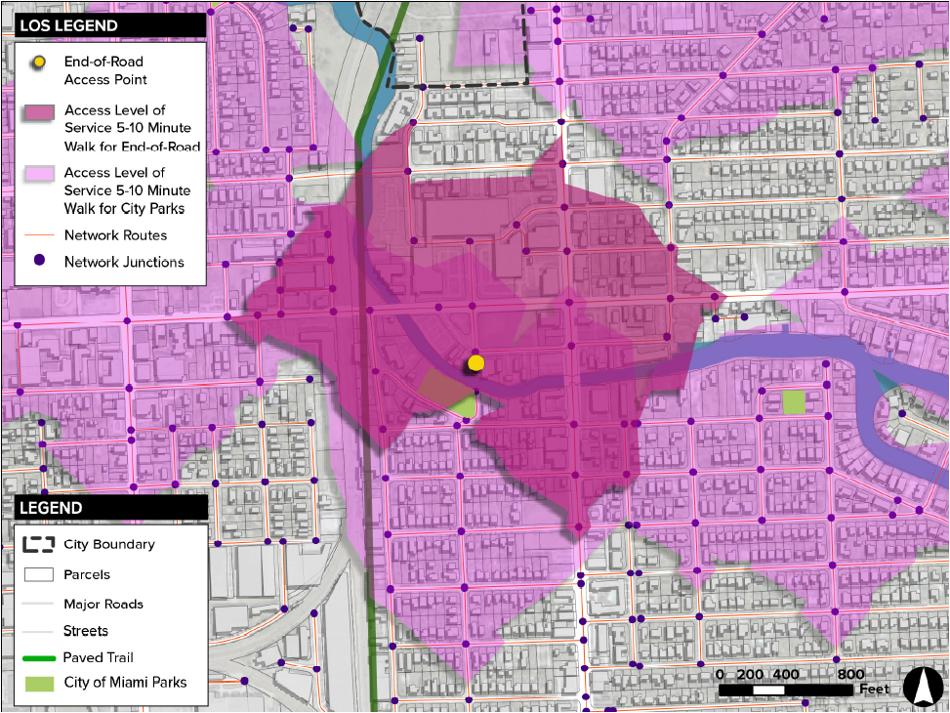
  Cost Estimates & Benefit Evaluation
Evaluated walkability and level of service benefits for new open space in end-of-road typologies

Slide 23
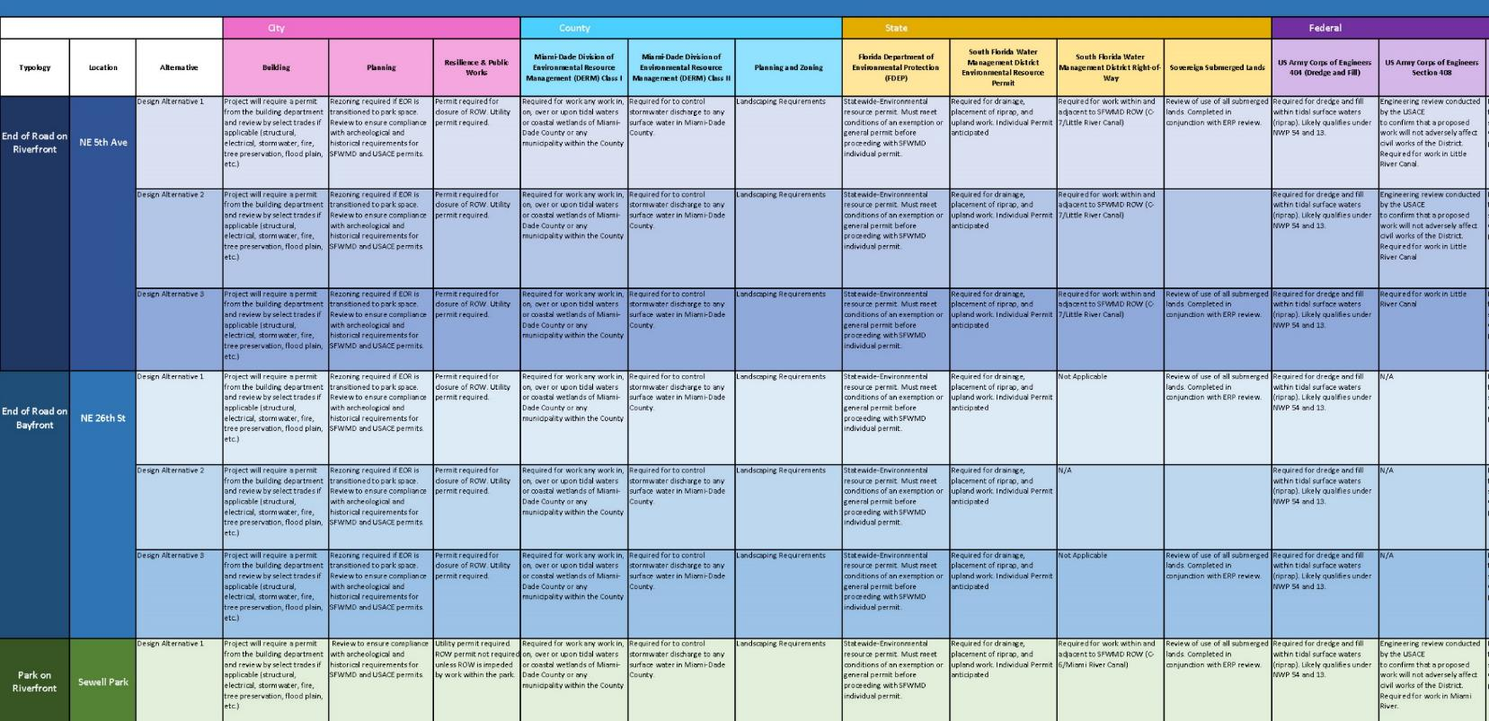
  Preliminary Permitting Investigation
Preliminary Matrix for City, County, State and Federal requirements

Slide 24
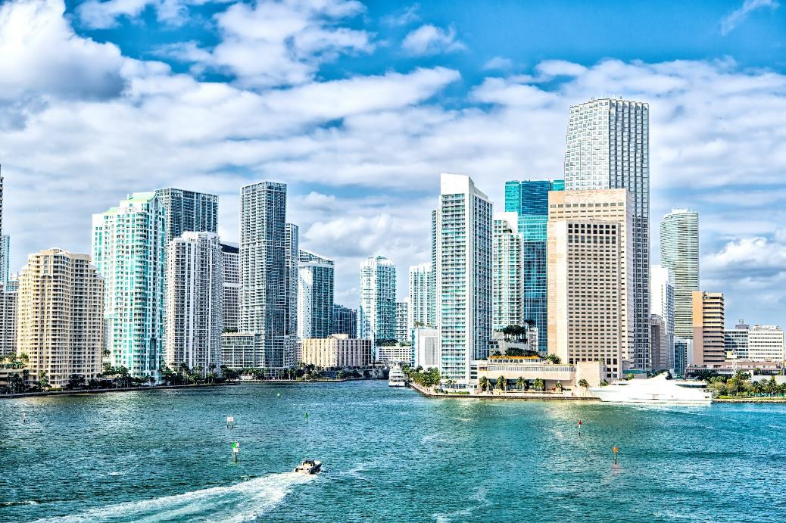
  Permitting Pre-Application Meetings
Agencies
  City of Miami
  Miami-Dade County RER & DERM
  South Florida Water Management District
  US Army Corps of Engineers

Slide 25
  Permitting Pre-Application Meetings: What We Learned
City of Miami
  Permitting process and agencies needed for review
  Additional stakeholders to engage
MD RER/DERM
  Elevations of proposed elements need to consider current County flood data
  Outfalls will trigger a Class II Permit, but may not be required with the green infrastructure in our designs
  Constructed wetlands need to have barriers between adjacent properties
  Permitting requirements would be reduced if proposed designs do not extend past the current mean high-water line

Slide 26
  Permitting Pre-Application Meetings: What We Learned
USACE
  Any designs that impede navigable waterways would need justification for impacts
  All projects would need an existing resource survey prior to moving into design
  Positive impacts are not necessarily frowned upon, but justification for all impacts is required
  Similar reference projects can provide lessons learned (Jose Marti, Brittany Bay Park)
  Proposals, including breakwater reefs would need to meet certain impact criteria and provide justification

Slide 27
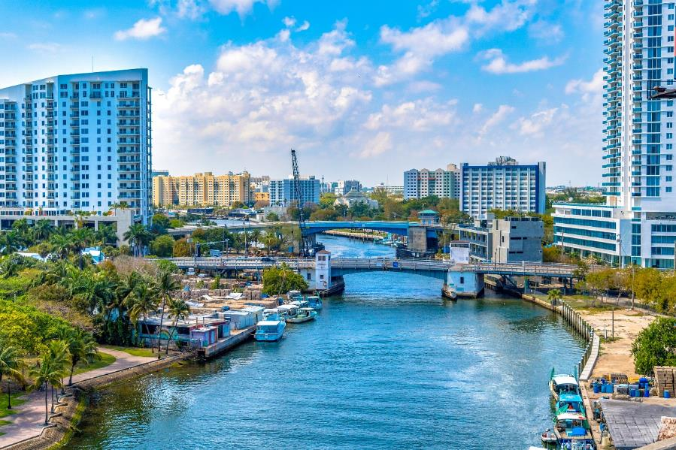
  Successful Implementation: What’s Needed
Planning & Zoning: Land use and zoning changes may be required for certain sites if they are intended to be parks
Formal Process: A formal process needs to be adopted to evaluate the level of amenities on sites, make decisions on land use updates, and plan for future maintenance
Project Phasing: Projects can be phased based on waterline/shoreline amenities/interior approach
Specialized Design and Maintenance: Different design and construction approaches will be utilized based on the specialization required for the work
Many of the design alternatives would require specialized maintenance contracts – maintenance management plans are critical

Slide 28
  Successful Implementation: What’s Needed, cont
  Funding & Financing: There are a variety of funding mechanisms that could be utilized, including FIND, FEMA Flood Mitigation Funding, HUD, Conservation funds, and GO Bonds
  Collaboration: Partnerships with private developers, property owners, Miami River Commission, and the DDA are necessary to promote nature-based designs across the waterfronts
  City Alignment: Policy and operation updates to help align these ideas with other efforts throughout the City

Slide 29
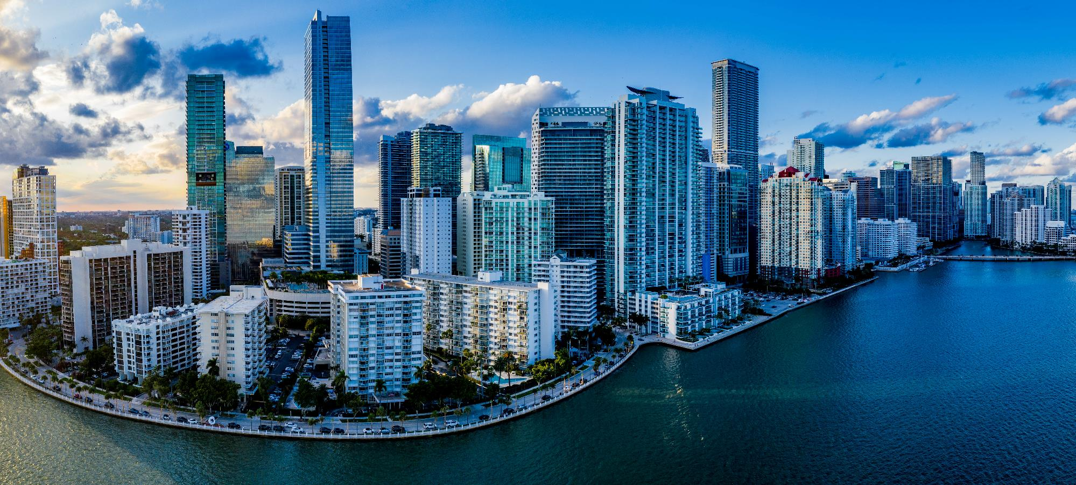
  Thank you!

